Slide 1
JAVA PROJECT | TEAM PRESENTATION
Online Store Cart
& Order Pipeline
A simple console-based shopping system built with Java
TEAM NO: _____8_____
Names & Roll Numbers: add your team detail
D.Sukriti 2620030493
T.Sahasra - 2620030108
Y.Geethika – 2620030519
15 OCTOBER 2026
01

Slide 2
Abstract
What our project does
A small online-shopping workflow
1
Browse
2
Add to cart
The program lets a user browse products, search by name, add items to a cart and calculate the bill.
View product names, prices and available stock.
Choose a product and quantity.
3
Calculate
4
Save order
Built to demonstrate Java concepts—not a full commercial store.
Get each item amount and the total bill.
Append order details to orders.txt.
Note: the supplied code saves order details, but does not yet implement order IDs or delivery-status tracking.
ONLINE STORE CART & ORDER PIPELINE • JAVA PROJECT
02

Slide 3
Understanding the Problem
From product choice to a final bill
1
2
3
4
5
6
›
›
›
›
›
View
products
Search
name
Check
quantity
Update
cart
Calculate
total
Save
order
Inputs
Processing
Outputs
Product name and requested quantity.
Find product, validate stock, update cart and sum amounts.
Cart details, total bill, validation messages and saved order.
ONLINE STORE CART & ORDER PIPELINE • JAVA PROJECT
03

Slide 4
CO 1 — Java Foundations
Variables, data types and operators in the code
1
Product data
2
Cart data
3
Calculations
id, name, price and stock store each product’s details.
quantity records how many units the user selects.
price × quantity gives an item amount; amounts are added for the total.
Example from the code
double getAmount() { return product.price * quantity; }
Presentation line: “We use variables to store product details and arithmetic operators to calculate the cost.”
ONLINE STORE CART & ORDER PIPELINE • JAVA PROJECT
04

Slide 5
CO 2 — Control Flow
Decisions and repetition
1
if statements
2
Loops
3
do–while menu
Check whether the product exists and whether the quantity is valid.
Repeat through products and cart items to display and process them.
Keeps the shopping menu running until the user chooses to exit.
Example check: quantity must be greater than 0 and must not exceed available stock.
Presentation line: “Conditions prevent invalid quantities, while loops let users perform more than one action.”
ONLINE STORE CART & ORDER PIPELINE • JAVA PROJECT
05

Slide 6
CO 3 — Methods & Modular Programming
Each method has a clear responsibility
1
displayProducts()
2
searchProduct(name)
3
addToCart()
Shows all available products
Finds a product by name
Validates quantity and updates cart
4
calculateTotal()
5
viewCart()
6
saveOrder()
Returns the cart total
Displays items and the bill
Writes the order to a text file
Presentation line: “We divided the program into methods so each task is easier to understand and maintain.”
ONLINE STORE CART & ORDER PIPELINE • JAVA PROJECT
06

Slide 7
CO 4 — Object-Oriented Programming
Classes model real items in the shopping system
class Product
class CartItem
id : int
product : Product
name : String
quantity : int
price : double
getAmount()
stock : int
Constructor initializes fields
display()
this refers to the current object
The code also uses static members for shared program data and try–catch to handle file-writing errors.
ONLINE STORE CART & ORDER PIPELINE • JAVA PROJECT
07

Slide 8
CO 5 — Strings & File Handling
Searching and saving order details
1
String handling
2
File output
3
Error handling
trim() removes extra spaces at the ends; equalsIgnore Case() matches names without case sensitivity.
File Writer and Print Writer write order details into orders.txt.
IOException is caught if saving the order fails.
Example: " laptop " is trimmed, then matched with "Laptop".
Presentation line: “We search product names using String methods and store each placed order in a text file.”
ONLINE STORE CART & ORDER PIPELINE • JAVA PROJECT
08

Slide 9
CO 6 — Collections, Lambdas & Streams
ArrayList stores products and cart items
products
cart
Laptop
CartItem
→
Headphones
CartItem
Mouse
CartItem
Keyboard
cart.stream().mapToDouble(CartItem::getAmount).sum()
Presentation line: “ArrayList holds our data, and a stream adds all item amounts to calculate the total.”
ONLINE STORE CART & ORDER PIPELINE • JAVA PROJECT
09

Slide 10
Conclusion
The Online Store Cart & Order Pipeline demonstrates how core Java concepts can be used to develop a simple console-based shopping system.
Java fundamentals: Variables, data types, operators, and conditional statements manage product details and validate quantities.
Methods and OOP: Modular methods and classes organize product and cart operations.
Collections and Streams: Array List stores products and cart items, while streams calculate the total bill.
File Handling: Order details are saved to orders.txt using Java file-writing classes.
Future Enhancements: The project can be extended with order IDs, delivery-status tracking, cart editing and removal, and database connectivity.
ONLINE STORE CART & ORDER PIPELINE • JAVA PROJECT
10

Slide 11
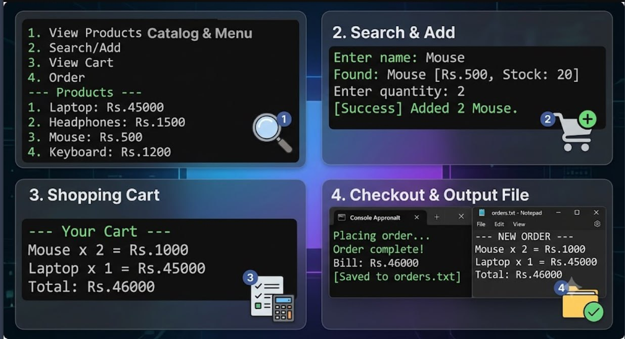

Slide 12
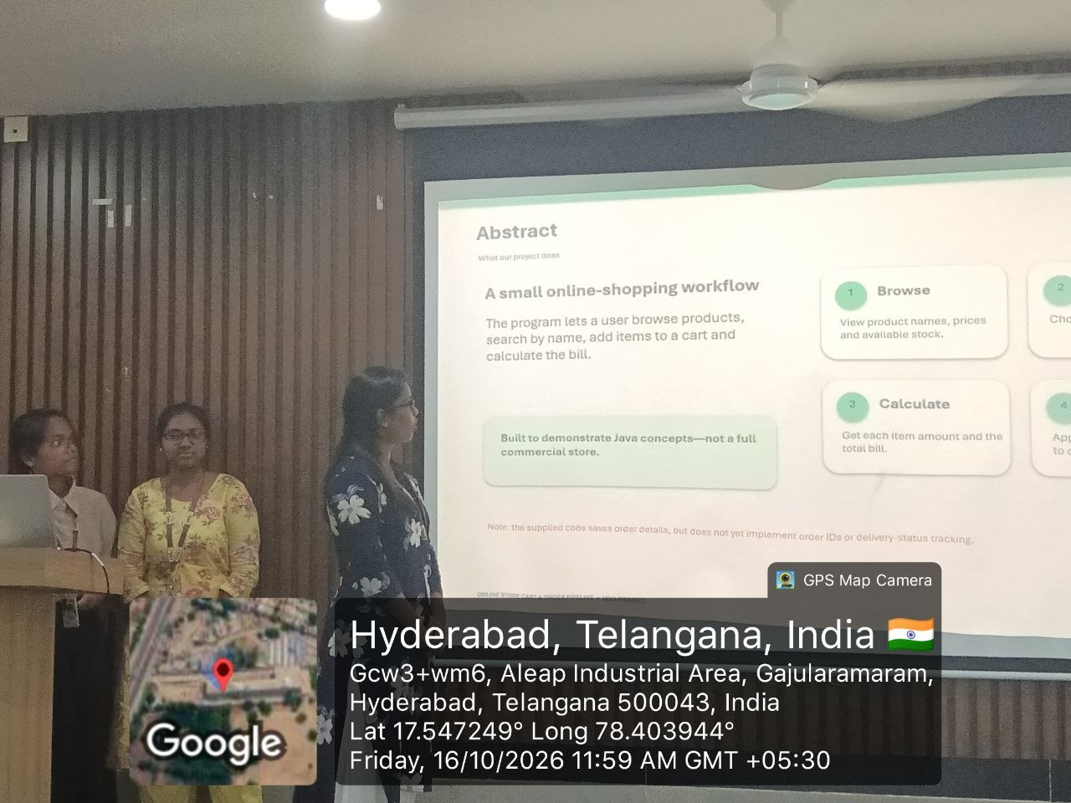
Team Photo & GitHub Repository
Complete these items before presenting
TEAM / GEO-TAG PHOTO
GITHUB REPOSITORY
Repository URL:
https://github.com/sukriti-tech/KLH_2026-27_T8_PSPJ_Online-shopping-cart
INSERT REQUIRED PHOTO HERE
Confirm the repository is accessible.
ONLINE STORE CART & ORDER PIPELINE • JAVA PROJECT
12

